Slide 1

Starbucks Distribution Analysis
The
Store Distribution Analysis

Slide 2
PARTICIPANT:
OLADELE OGUNSANYA

Slide 3
Brief History
Starbucks is a place of worship for coffee growers. It is a chain of cafeterias-coffee shops, with more than 17,000 establishments spread over 49 countries. Some people go through the cities looking for their logo to sit on a sofa and browse their Wi-Fi enjoying a great cup of coffee.
However, its logo has not always been as we know it and, in fact, it has undergone great changes since its creation in 1971. In fact, those who only know the modern logo and have surely wondered who this woman is, and what she has in hands,
History has the explanation for this mystery.

Slide 4
ABOUT THE PROJECT
This Project is set to Determine How Starbucks Coffee company is been distributed in the United States of America and Globally.
It also going to show the Relationship between Store owners and the Population Demographics.
The Project also determine how Weather (Climatic Impact) Affect sales where the Starbucks Stores are located.

Slide 5



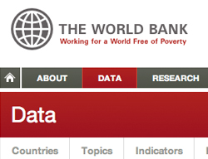





DATA SOURCES
TECHNICAL TOOLS

Slide 6
MACHINE LEARNING –
In this Project I was able to Merge three(3) Datasets together in other to be able to get an output. So I merged the Starbucks Datasets and also the Census tracts Dataset joined on Postcodes. Trying to Determine all other Coffee Shop located near Starbucks in the USA I was able to use google API to generate the Data of nearby coffee shop around but couldn’t get an accurate result which I tried everything to get it right but few shops showed up.
PURPOSE – To Predict Starbucks Coffee Shops in the US Based on People’s House Hold Income, Income Per Capita, Population and Median Age.
METHOD - After Several Attempts to Predict, Train and Test the Data that I used I was getting a several Low Test, Train results until I was able to Convert a column from the Data frame which is the Starbucks Store column to bins (Binary numbers) and Substituted to (y)
I was able to use Random Forest Analysis, Confusion Matrix, Mean Squared Error(MSE) and K_Nearest_Neighbor(KNN) to Test , Train and Predict the Data.

Slide 7
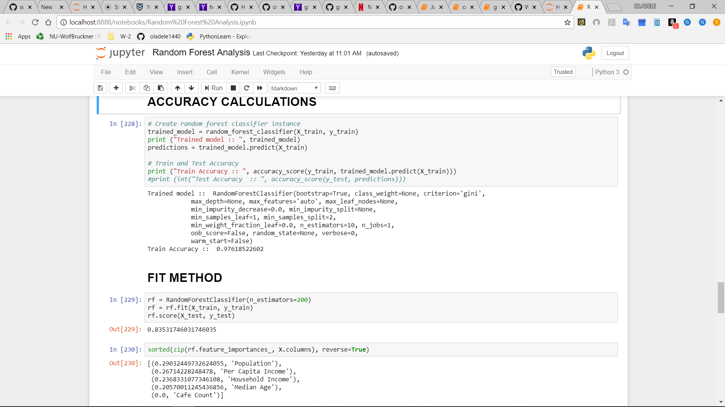
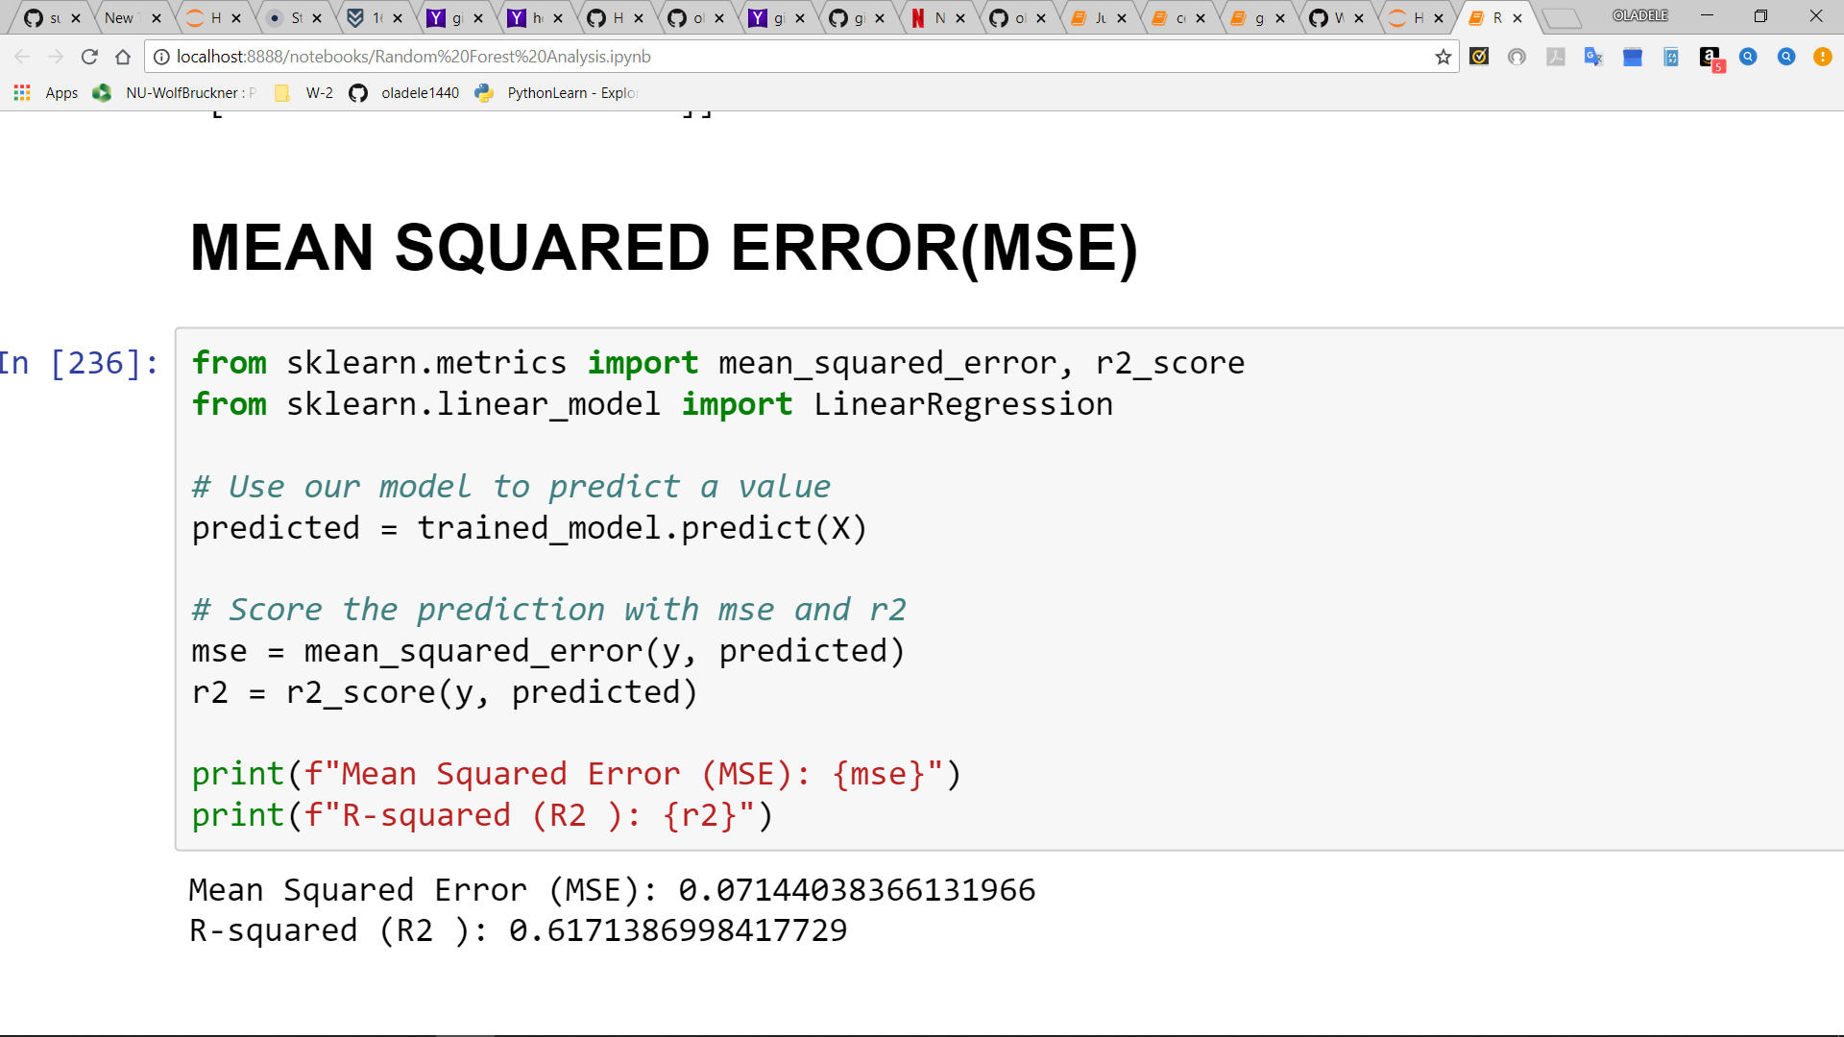
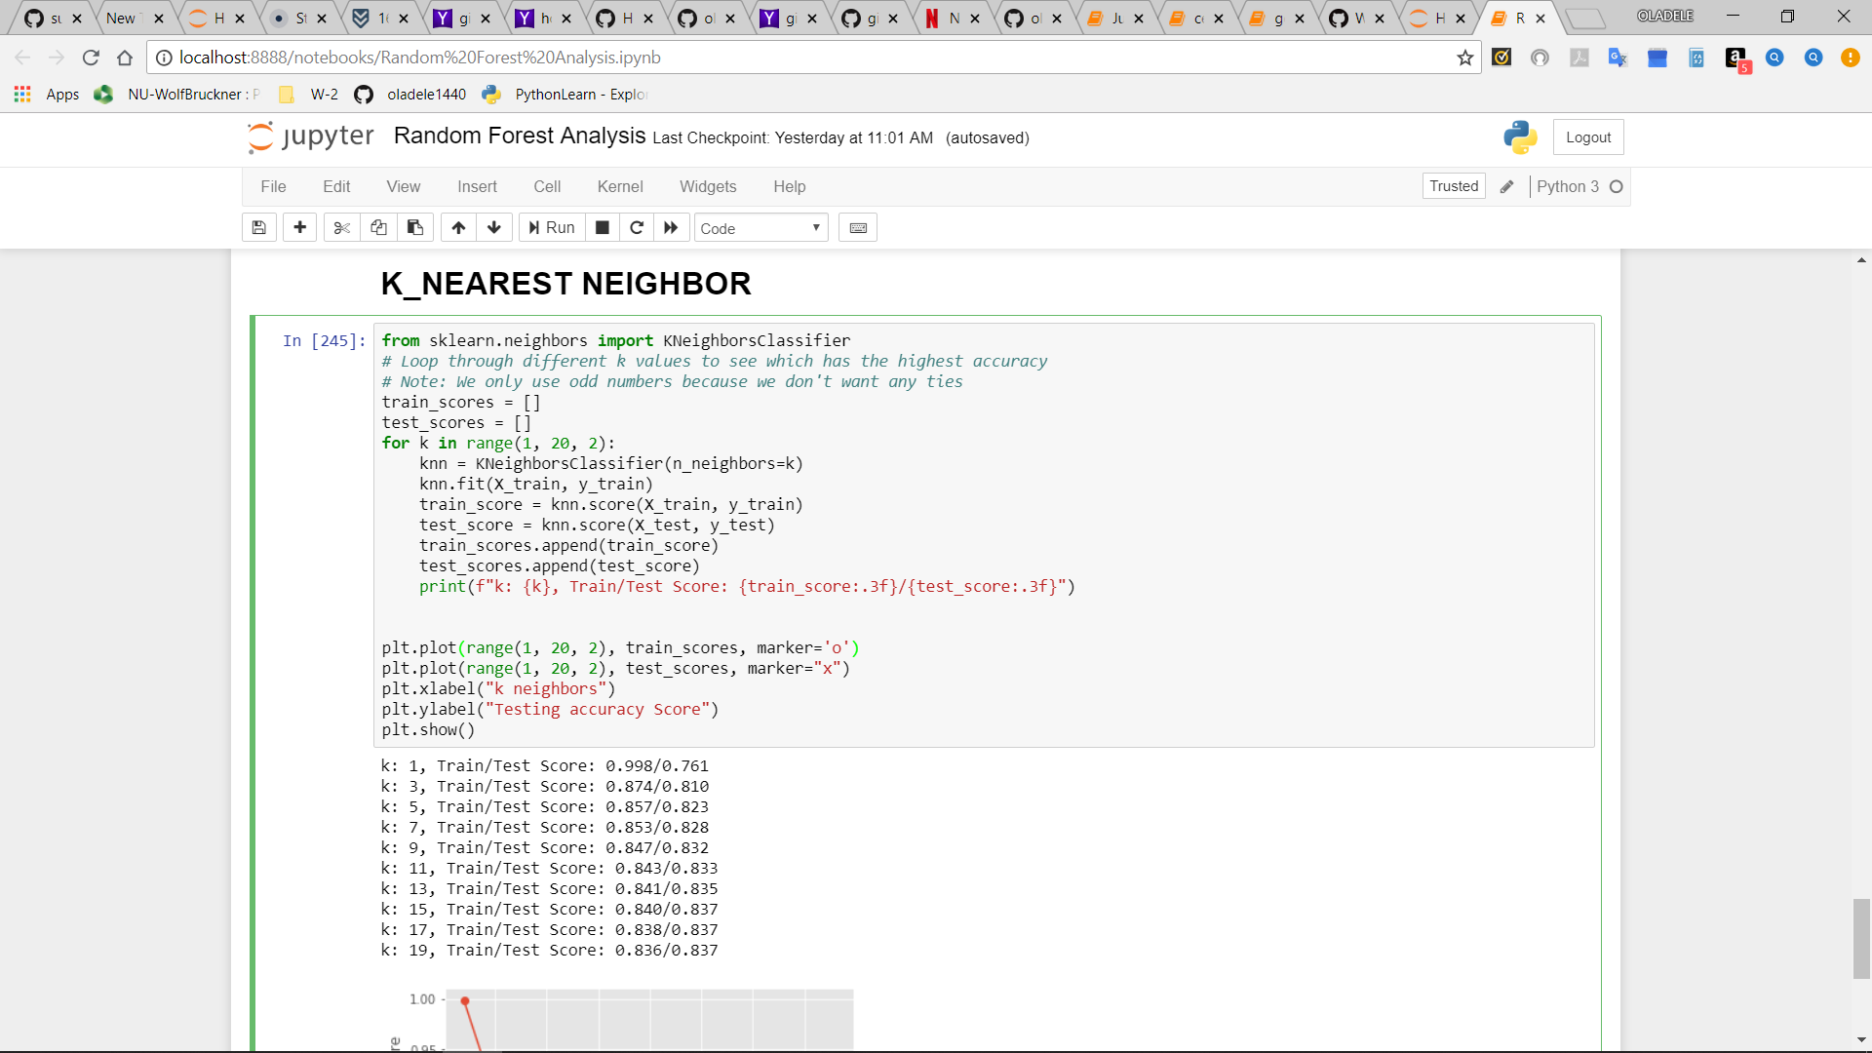
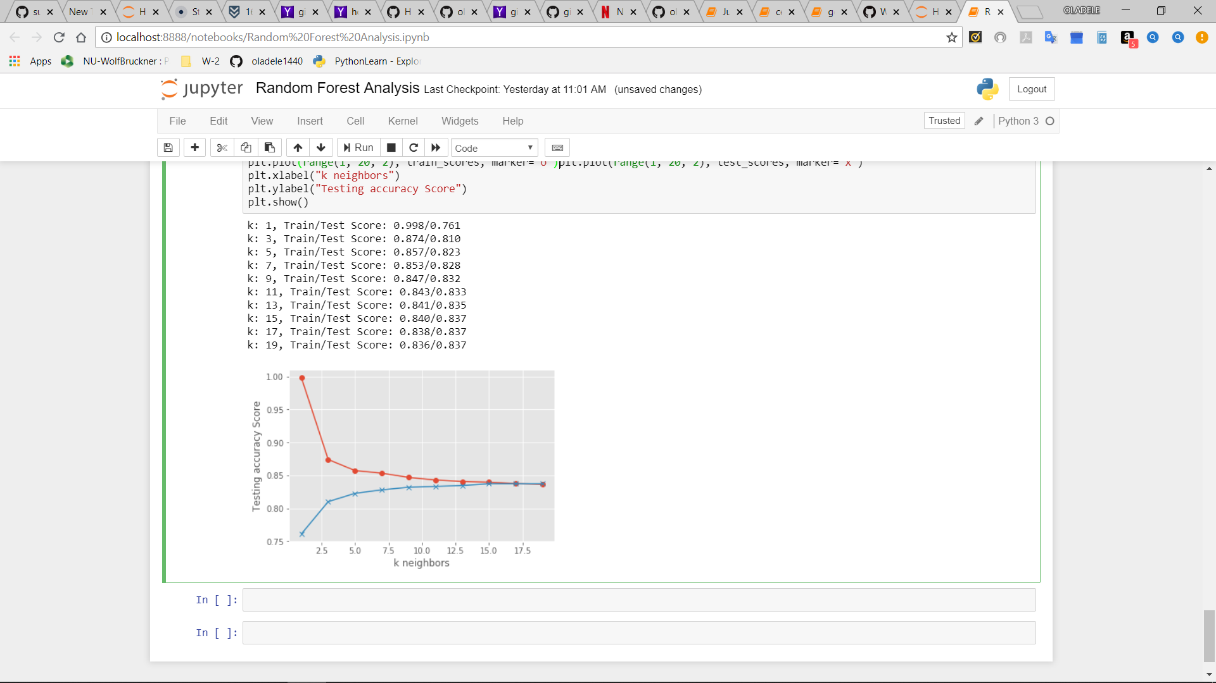

Slide 8
General Overview and Questions
How is the Starbucks stores distributed in the Us and globally?
Does store ownership have any demographic relationship?
Does climate have any impact on store distribution?

Slide 9

STARBUCKS LOCATION BASED ON INCOME
Starbucks Distribution Across USA
store distribution Across the US
How competitive is the coffee business

Slide 10

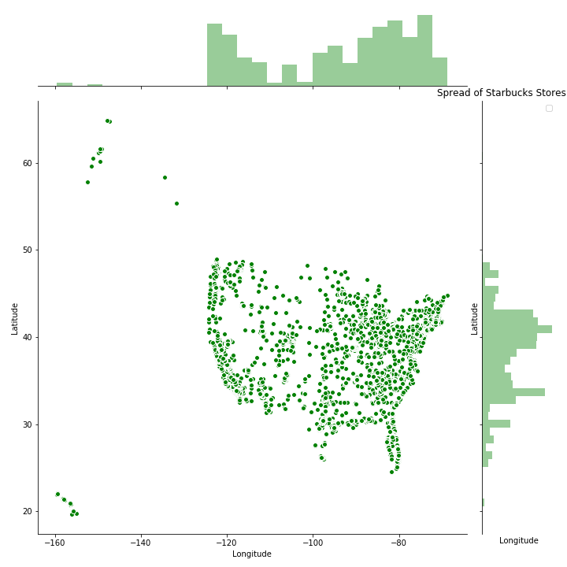
Starbucks Stores across United States:
There are 13,930 Starbucks Stores Across the US as at 2017 till Date.
8,222 Stores are Company Operated while 5708 are Licensed Stores

Slide 11

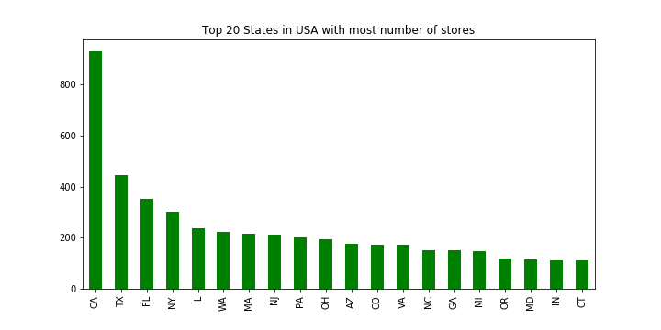
Starbucks STORES Vs Nearby Coffee Shops by Zip codes
From the bar chart Visualization, Picking the first 20 stores all over USA, California obviously has the highest number of Stores,
Followed by Texas and the 20th State is Cincinnati.

Slide 12
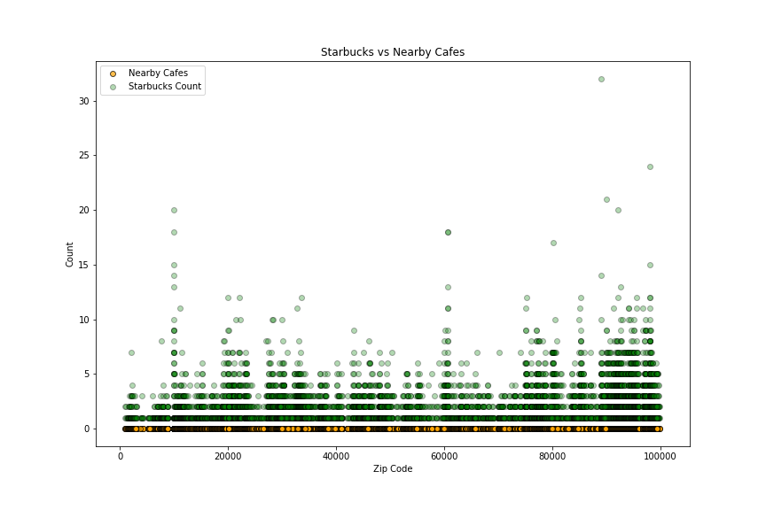
Starbucks STORES Vs Nearby Coffee Shops by Zip codes
The Scatter plot shown in this diagram is not 100% accurate because while i was using the google API to generate every
nearby Store around all the Starbucks shop, I was not getting the correct data to display all the nearby store.
Because looking at the Scatter it is showing that 90% of every coffee shop in the US are Starbucks which is absolutely
not true but the Google API search was able to Display few of the nearby stores which is represented by the yellow dots.
So with this Approach I can’t really tell how Competitive all nearby Coffee stores are to the Starbucks shop in the US.

Slide 13
Starbucks Demographics Distribution Facts Across the USA
Does population per state or race have any relationship with store count ?
Does Starbucks target a specific age group?
Does income have any relationship with store distributions?

Slide 14
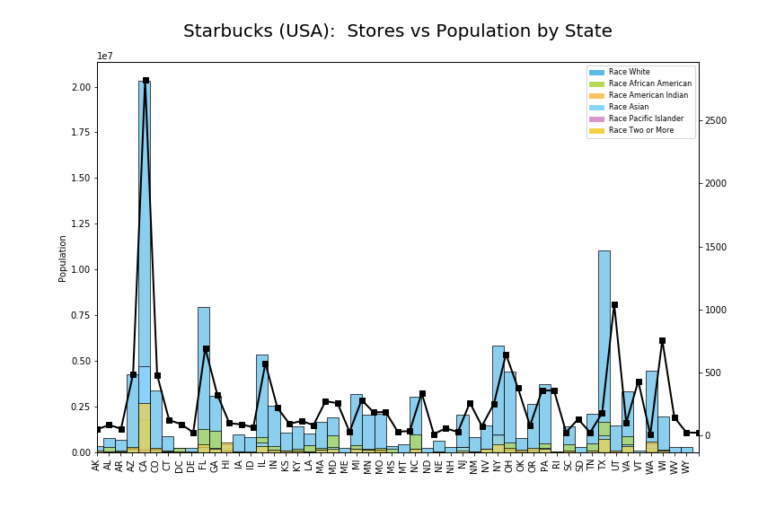
Starbucks Stores Count based on Race in the US by STATE
As we can see from the Bar Chart that California, Texas, Florida, New York and Illinois
[2821, 1,042, 694, 645, 575] pretty has a the highest number of Store across the US, Which obviously indicates that there a relationship of Starbucks Stores and Population.
Also Washington DC, Detroit, Arkansas, North Dakota, Vermont , Rhode Island and Wyoming has few Stores which could depend on Population around these states.

Slide 15
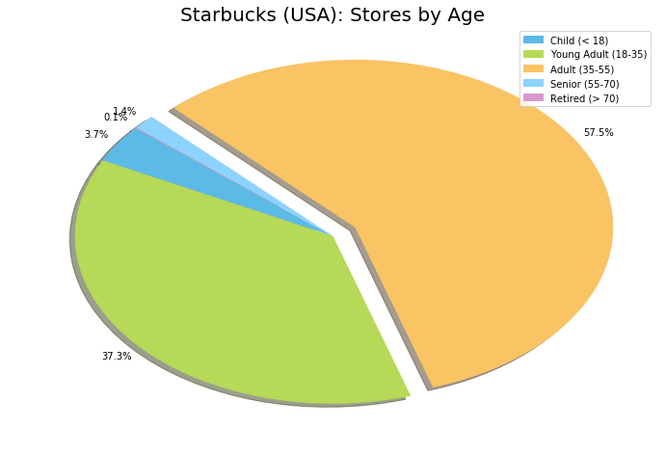
STARBUCKS TARGET BY AGE GROUP
Based on the Pie Chart Analysis, Starbucks stores target the Age group individuals 35-55 (57.5%)
Young Adult Individual 18-35 (37.3%)
And Few number of Store are found amongst individual 55-70 (3.7%)

Slide 16
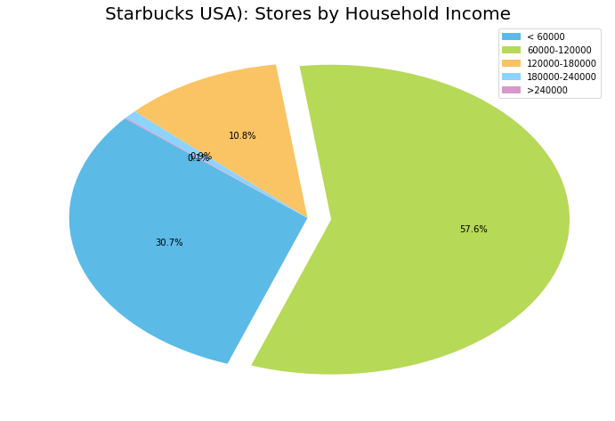
STARBUCKS TARGET BY HOUSEHOLD INCOME
Based on the Pie Chart Analysis, Starbucks stores target the individuals that earns 60,000 – 120,000 (57.6%)
Young Adult Individual that earns less than 60,000 (30.7%)
And Few number of Store are found amongst individual that earns 180,000 – 240,000 (10.8%)

Slide 17
STARBUCKS GLOBAL DISTRIBUTION ANALYSIS
Also,
There are Only three(3) countries in Africa that has Starbucks Stores, Which are Morocco, Egypt and South Africa
And Few of the Stores are scattered in the Middle East
As Observed from the link below,
There are a lot of Starbucks Store Distribution
In the Continent of North America, Europe and Also Asia.
https://sunkanmi.carto.com/builder/c091e279-b1df-4540-b5b8-15da62e445c3/layers

Slide 18
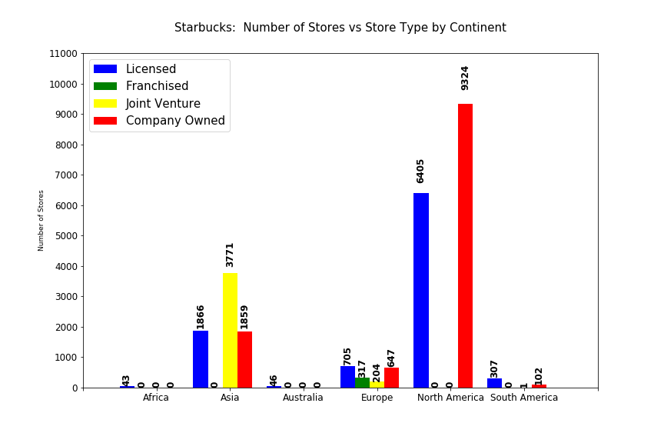
STORE OWNERSHIP VS DEMOGRAPHIC RELATIONSHIP
From the Bar Chart
It Shows that Most Starbucks Stores in North America are Company Owned and a lot of them are Licensed Owned as well
Asia Stores are Mostly Joint Ventures and Few Company and Licensed Owned
Europe has almost Equal Licensed and Company owned Stores
Zero Stores in Australia
And Few Stores are Licensed owned on South Africa

Slide 19
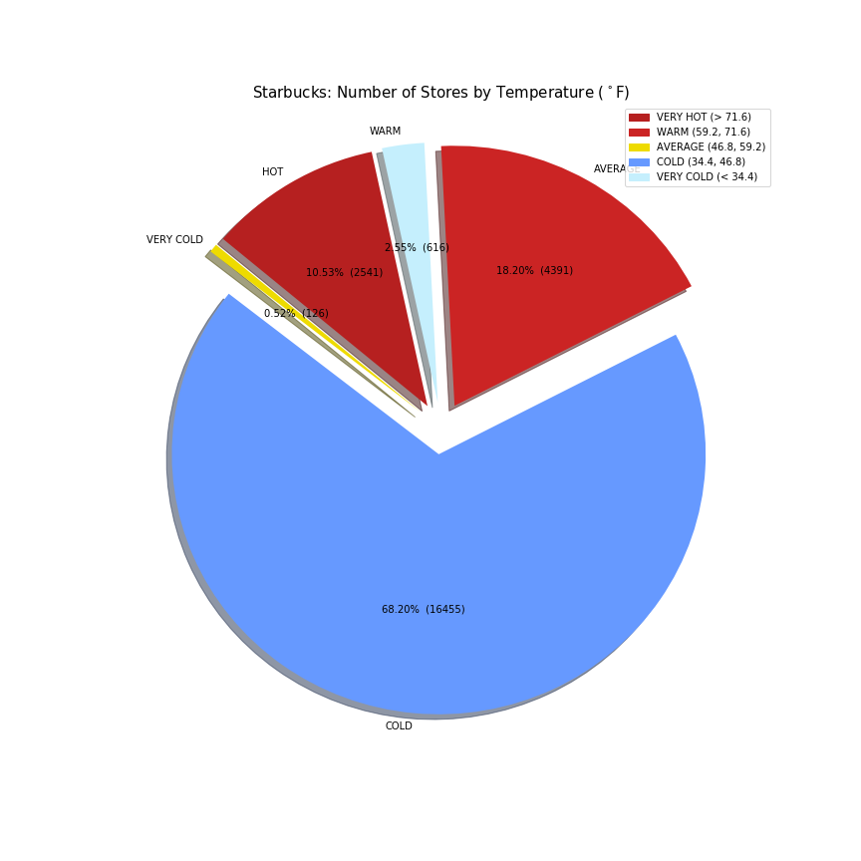
Climate impact on Starbucks stores globally
From the Pie Chart
It Shows that Most Starbucks Stores are Situated in Cold Region about 68.20% of the Stores are based in Cold Countries globally.
18.20% of the Stores are in Warm Countries.
10% of the Stores are in Hot Region

Slide 20


